Slide 2
why use random forest in sklearn?
make comparison with other models

Slide 3
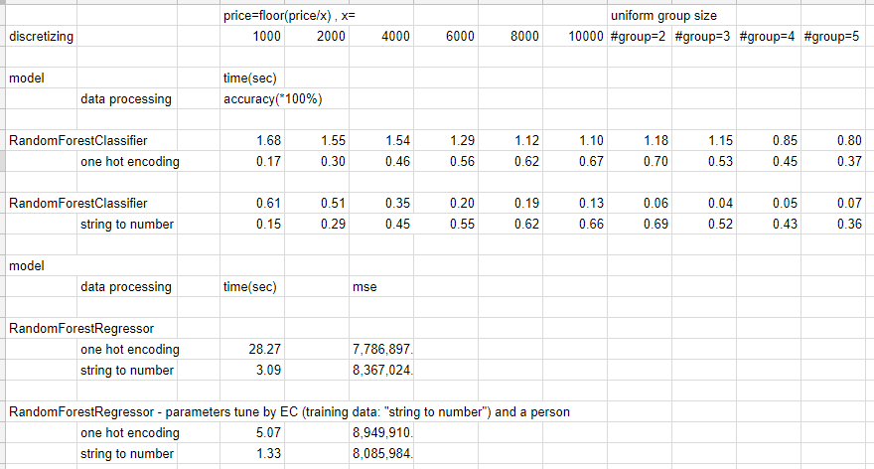
result

Slide 4
result
Random forest can take continuous features. Thus, there’s no experience of all feature one hot encoded.
Compared with NB, almost same accuracy at each condition, but slower.
For regressor version, MSE are very large. It’s probably that some values are too big, and mean is not enough to lower down the squared error as others.
There’re some intresting result at below. As we don’t know what parameters can be the best, let computer decide for us, and the resulting MSE becomes smaller.
* random search via evolution computation approach, searching values of parameters of { max_features, bootstrap, min_samples_split, min_samples_leaf, min_weight_fraction_leaf, min_impurity_decrease, max_depth }

